Slide 1
FINAL PROJECT
CACHE SIMULATION
Group 2
Nguyễn Đức Hưng (Leader)
Lê Đình Bảo Tín Trần Chí Thành

Slide 2
Tables of Contents
Introduction
Project Summary
Cache Specifications
Operations Implementation
Testing and Verification
Simulate a program

Slide 3
1. INTRODUCTION

Slide 4
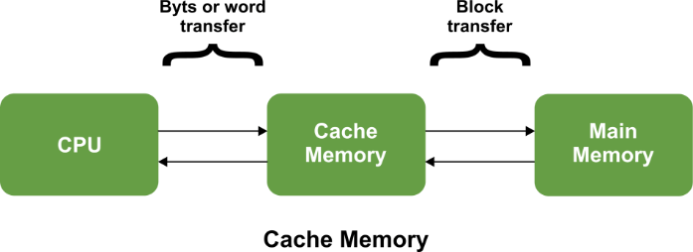
Why do we need cache?
CPU speed >> Memory speed
Program exhibit “Principle of Locality”: temporal and spatial
Loop
Sequential access to array
Instruction fetch,....
Adding Cache to memory hierarchy!
Goal of project: Simulate the behavior of Cache system using C language

Slide 5
2. PROJECT OVERVIEW

Slide 6
L1 ⇔ L2 message displaying:
What do we do?
Simulation by trace file:
Displaying Mode:
The L1 ⇔ L2 message is displaying by following format:
<message> <address>
Design a 2-level Cache simulation program for a 32-bit processor
NO Cache Coherence required!
1 | Read data
2 | Write data
3 | Read for Ownership
0 | Read data
1 | Write data
2 | Instruction Fetch
3 | L2 Eviction command
8 | Clear cache + statistics
9 | Print Cache summary
Contain multiple lines with following format:
<operation> <address>
Mode 0 (for each L1 Cache) | Mode 1
Cache content (Valid line only) # of Read/Write Accesses # of Hits/Misses # Hit Ratio | Mode 0 + L1 ⇔ L2 message

Slide 7
3. CACHE SPECIFICATIONS

Slide 8
Addressing:
Both L1 Data Cache and L1 Instruction Cache
Tag | Set Index | Bytes offset
12 bits
14 bits
6 bits
16K Sets = 2¹⁴ Sets ⟶ 14 bits for “Set Index”
Cache Line size = 64 bytes = 2⁶ ⟶ 6 bits for “Bytes offset”
Tag size = 32 (address size) ー 14 ー 6 = 12 bits for “Tag”

Slide 9
Cache Line:
Instruction Cache Line
Valid: 1 bit
LRU: 1 bit
Tag: 12 bits
Data: 512 bits
Data Cache Line
64 bytes of Data ≃ 512 bits of Data
Valid: 1 bit
Dirty: 1 bit
LRU: 2 bit
Tag: 12 bits
Data: 512 bits
12 bits for Tag field (Calculated above)
With similar arguments above, we can derive: 1 bit Valid, 12 bits Tag and 512 bits Data
2-ways associative ⇒ 2 states LRU ⇒ 1 bit for LRU field
1 bit for Valid state of cache line
4-way associative ⇒ 4 states LRU ⇒ 2 bits for LRU field
Data cache use “write back, write allocate” policies ⇒ 1 Dirty bit

Slide 10
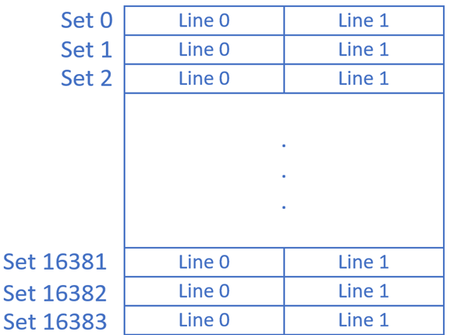
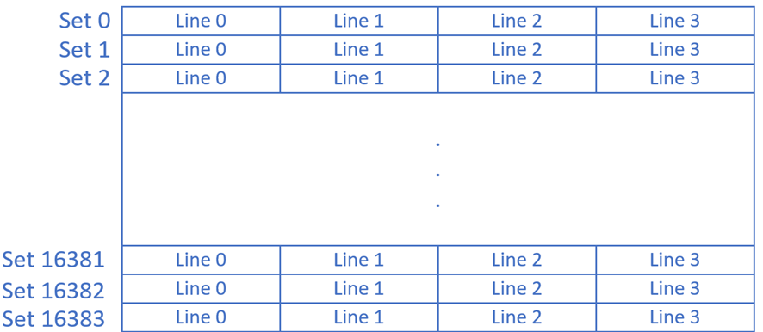
Cache Structure:
Instruction Cache | Data Cache
2-way associative
4-way associative
16K Sets

Slide 11
4. OPERATIONS
IMPLEMENTATION

Slide 12
Read Data & Fetch Instruction:
Read Data Cases: 6 cases
IF is similar to Read but no DIRTY!
Read
End
What about instruction fetch (IF)?
1
1
Addr_Tag==Line_Tag?
1
Line_Valid?
0
Evict INVALID Line
1
0
Read from L2 ⇒ Read
Start
0
0
EmptyLine?
1
1
Evict Line
Write back Dirty LRU Line
0
0
0
0
Line_Valid?
0
LRU_Line Dirty?
1
0
1
1
1
Find LRU
Evict Line

Slide 13
Write Data:
Write Data Cases: 6 cases
Write ⇒ Dirty=1
End
1
1
1
0
Addr_Tag==Line_Tag?
1
Line_Valid?
0
Evict INVALID Line
Read from L2 ⇒ Write ⇒ Dirty =1
Start
0
0
1
EmptyLine?
1
Evict Line
Write back Dirty LRU Line
0
0
0
0
Line_Valid?
0
LRU_Line Dirty?
0
1
1
1
1
Find LRU

Slide 14
Eviction from L2 to L1:
Eviction: 4 cases
Evict_Tag==Line_Tag?
0
0
Start
ERROR: Line not found
End
1
1
Line->Valid==0?
0
0
Ignore the line
1
1
0
Line->Dirty==0?
0
Set Line Valid=0
1
1
Write back dirty Line

Slide 15
5.Testing and Verification

Slide 16
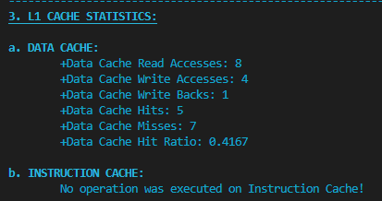
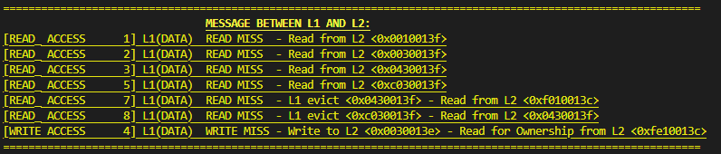
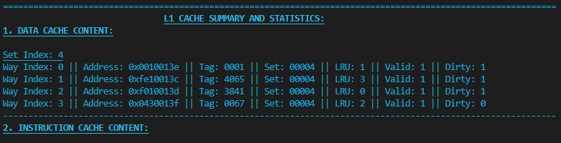
Read/Write Test:
2nd - Compare! - L1 ⇔ L2 messages
2nd - Compare! - L1 summary!
2nd - Compare! - L1 Statistics!
1st - Calculate expected result by hand!
Set 4 | V|D|LRU
L0
L1
L2
L3
R 0010013F
R F010013C
W 0030013E
R 0030013F
W F010013D
R 0430013F
W 0010013E
R 0030013B
R 0430013F
R C030013F
W FE10013C
R 0010013C
1|0|1
0|0|0
1|0|3
1|0|2
1|0|1
1|0|1
1|0|0
1|0|3
1|0|2
1|0|1
1|1|3
1|1|2
1|1|1
0x0010013F
0x0010013C
0x0010013C
0x0010013C
0x0010013F
0x0010013E
0x0010013F
0x0010013F
0x0010013F
0x0010013C
0x0010013E
0x0010013E
1|1|2
0|0|0
0|0|0
1|0|3
1|0|2
1|0|3
1|0|2
1|0|1
1|0|0
1|1|3
1|1|1
1|1|0
1|1|3
0x00000000
0x0030013B
0x0030013E
0x0030013E
0x0030013F
0x0030013E
0x0030013F
0x0030013B
0x0030013B
0x0030013B
0x0030013E
0xFE10013C
0x00000000
0xF010013C
0xF010013C
0xF010013D
0x0430013F
0xF010013D
1|1|3
0x00000000
0x0430013F
0x0430013F
0x0430013F
0|0|0
0xF010013D
0xF010013D
0|0|0
0|0|0
1|0|3
1|0|2
1|0|1
1|0|0
1|0|3
1|0|2
1|1|2
1|1|1
1|1|0
1|0|0
0|0|0
0|0|0
0|0|0
0|0|0
0|0|0
1|0|3
1|0|2
1|0|1
1|0|0
1|0|0
1|0|3
1|0|2
0x00000000
0xC030013F
0xC030013F
0xC030013F
0x00000000
0xC030013F
0x00000000
0x00000000
0xC030013F
0xC030013F
0x0430013F
0x0430013F
(1) UM ⇒ Read from L2 <0x0010013F>
(2) UM ⇒ Read from L2 <0x0030013F>
(3) UM ⇒ Read from L2 <0x0430013F>
(5) UM ⇒ Read from L2 <0xC030013F>
(7) CM ⇒ L1 evict <0x0430013F> ➡ Read from L2 <0xF010013C>
(11) CM ⇒ L1 evict <0xC030013F> ➡ Read from L2 <0x0430013F>
(12) CM ⇒ L1 write back <0x0030013E> ➡ RFO from L2 <0xFE10013C>

Slide 17
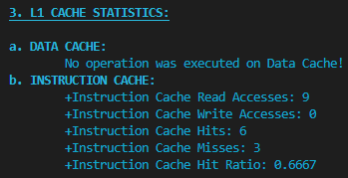
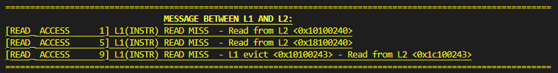

Instruction Fetch:
1st - Calculated expected results by hand!
2nd - Compare! - L1 ⇔ L2 messages!
2nd - Compare! - L1 Instruction Cache Content!
2nd - Compare! - L1 Statistics!
Set 9 | V|LRU
L0
L1
Set 9 | V|LRU
L0
L1
IF 10100240
IF 10100241
IF 10100242
IF 10100243
IF 18100240
IF 18100241
0|0
1|1
1|0
0x10100240
0x10100241
0x10100242
0x10100243
0x10100243
0x10100243
0|0
0|0
1|1
0x00000000
0x00000000
0x00000000
0x00000000
0x18100240
0x18100241
IF 18100242
IF 18100243
IF 1C100243
0|0
0x10100243
0x10100243
0x1C100243
1|0
1|1
0|0
1|1
1|0
0x18100242
0x18100243
0x18100243
(1) UM ⇒ Read from L2 <0x10100240>
(5) UM ⇒ Read from L2 <0x18100240>
(9) CM ⇒ L1 Evict <0x10100243> Read from L2 <0x18100240>

Slide 18
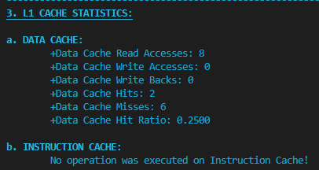
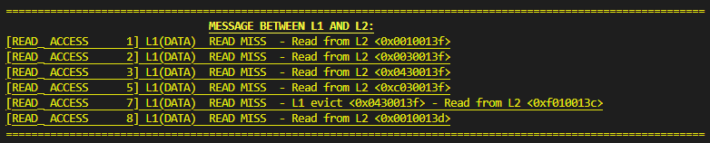
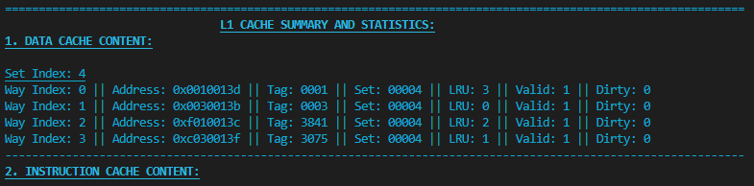
Eviction Test:
2nd - Compare! - L1 Statistics!
1st - Calculated expected result by hand!
2nd - Compare! - L1 ⇔ L2 messages!
2nd - Compare! - L1 Content!
Set 4 | V|D|LRU
L0
L1
L2
L3
R F010013C
R 0010013F
I 0010013E
R 0030013F
R 0010013D
R 0430013F
R 0030013B
R C030013F
R 0010013C
1|0|3
1|0|2
0|0|2
0|0|0
1|0|3
1|0|2
1|0|1
1|0|1
1|0|0
1|0|3
0x0010013F
0x0010013E
0x0010013C
0x0010013F
0x0010013F
0x0010013D
0x0010013F
0x0010013F
0x0010013C
1|0|0
1|0|0
1|0|0
0|0|0
0|0|0
1|0|3
1|0|2
1|0|3
1|0|2
1|0|1
0x00000000
0x0030013B
0x0030013B
0x0030013F
0x0030013F
0x0030013B
0x0030013B
0x0030013B
0x0030013B
0x00000000
0xF010013C
0xF010013C
0x00000000
0x0430013F
1|0|2
0xF010013C
0x0430013F
0x0430013F
0x0430013F
1|0|3
1|0|3
0|0|0
0|0|0
0|0|0
1|0|3
1|0|2
1|0|1
1|0|0
1|0|1
1|0|1
1|0|1
0|0|0
0|0|0
0|0|0
0|0|0
0|0|0
1|0|3
1|0|2
0x00000000
0xC030013F
0xC030013F
0x00000000
0x00000000
0xC030013F
0x00000000
0xC030013F
0xC030013F
(1) UM ⇒ Read from L2 <0x0010013F>
(2) UM ⇒ Read from L2 <0x0030013F>
(3) UM ⇒ Read from L2 <0x0430013F>
(5) UM ⇒ Read from L2 <0xC030013F>
(7) CM ⇒ L1 Evict <0x0430013F> ➡ Read from L2 <0xC030013F>
(9) UM ⇒ Read from L2 <0x0010013D>

Slide 19
6. SIMULATE A PROGRAM

Slide 20
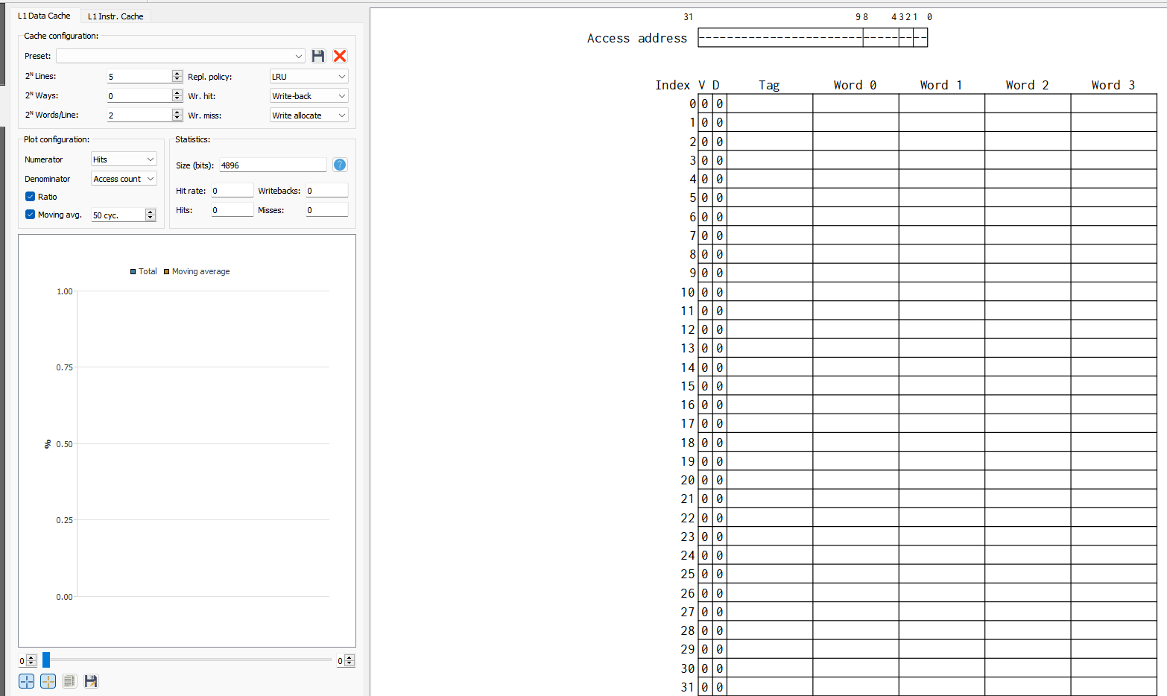
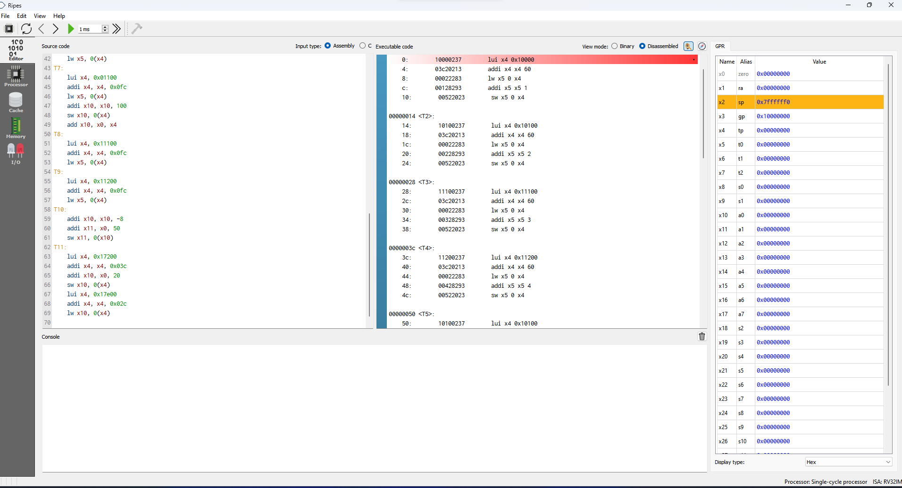
Ripes and Ripes Cache Simulator:
Ripes is a RISC-V ISA simulator (both 32-bit and 64-bit)!
Ripes support split L1 cache simulator!
Ripes allows adjustment on Associativity and Policies of cache!

Slide 21
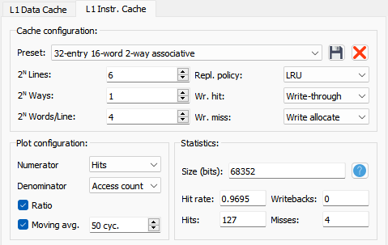
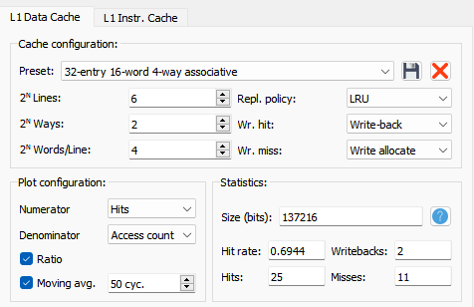
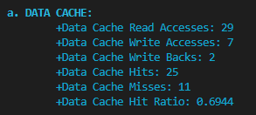
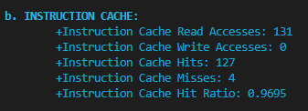
Simulate Simple Program:
Write a simple assembly program which read data, modify them and then store new data into the memory
Convert the program to trace files format!
Simulate the program in Ripes and obtain Cache statistics!
Simulate the trace files!
Compare the result in step 3 and 4!
Convert to trace file: 2 00000000 //lui x4, 0x10000 - T1 2 00000004 //addi x4, x4, 0x03c 2 00000008 //lw x5, 0(x4) 0 1000003c //Read data at 0x1000003c 2 0000000c //addi x5, x5, 1 2 00000010 //sw x5, 0(x4) 1 1000003c //Write data to 0x1000003c … … … | 2 000000bc //lui x4, 0x17200 - T11 2 000000c0 //addi x4, x4, 0x03c 2 000000c4 //addi x10, x0, 20 2 000000c8 //sw x10, 0(x4) 1 1720003c //Write data to 0x1720003c 2 000000cc //lui x4, 0x17e00 2 000000d0 //addi x4, x4, 0x02c 2 000000d4 //lw x10, 0(x4) 0 17e0002c //Read data at 0x17e0002c 9
Main: T1: lui x4, 0x10000 addi x4, x4, 0x03c lw x5, 0(x4) addi x5, x5, 1 sw x5, 0(x4) … … … | T11: lui x4, 0x17200 addi x4, x4, 0x03c addi x10, x0, 20 sw x10, 0(x4) lui x4, 0x17e00 addi x4, x4, 0x02c lw x10, 0(x4)

Slide 22
Thanks for your listening <3

